Slide 1
Chapter 6
Semantic Analysis
语法分析过程中的语义动作（计算）
语法：表达形式
语义：内涵
Intro
Static semantic analysis
attribute grammar
AST
timepoint

Slide 2
outline
Attributes and attribute grammars

Slide 3
6.1 Attributes and attribute grammars
Attributes: any property of a programming language construct such as
  The data type of a variable
  The value of an expression
  The location of a variable in memory
  The object code of a procedure
  The number of significant digits in a number
Attributes might be
  fixed prior to the compilation process.
  determinable only during program execution.

Slide 4
6.1 Attributes and attribute grammars
Binding of the attribute: the process of computing an attribute and associating its computed value with the language construct in question.
Binding time: the time during the compilation/execution process when the binding of an attribute occurs.

Slide 5
6.1 Attributes and attribute grammars
Binding times of different attributes vary, and even the same attributes can have quite different binding times from language to language.
Static attributes\Dynamic attributes: Based on the difference of the binding time
be bound prior to execution
be bound during execution

Slide 6
6.1 Attributes and attribute grammars
A type checker: is an important part of semantic analysis (in a language like C or Pascal)
A type checker is an analyzer
  computes the data type attribute of all language entities for which data types are defined
  verifies that these types conform to the type rules of the language.

Slide 7
6.1 Attributes and attribute grammars
• Type checking = set of rules that ensure the type
consistency of different constructs in the program
• Examples:
  The type of a variable must match the type from its declaration
  The operands of arithmetic expressions (+, *, -, /) must have integer types; the result has integer type
  The operands of comparison expressions (==, !=) must have integer or string types; the result has boolean type

Slide 8
6.1 Attributes and attribute grammars
More examples:
  For each assignment statement, the type of the updated variable must match the type of the expression being assigned
  For each call statement foo(v₁, …, v_{n}), the type of each actual argument v_{i} must match the type of the corresponding formal argument f_{i} from the declaration of function foo
  The type of the return value must match the return type from the declaration of the function

Slide 9
6.1.1 Attribute grammars
X.a : the value of a associated to X
X is a grammar symbol and a is an attribute associated to X.
syntax-directed semantics: attributes are associated directly with the grammar symbols of the language.
Given attributes a₁, a₂, … , a_{k}, for each grammar rule X₀→X₁ X₂ … X_{n} ( X₀ is a nonterminal ), the values of the attributes X_{i}.a_{j} of each grammar symbol X_{i} are related to the values of the attributes of the other symbols in the rule.

Slide 10
6.1.1 Attribute grammars
An attribute grammar for attributes a₁, a₂, … , a_{k} is the collection of all attribute equations or semantic rules of the following form, for all the grammar rules of the language.
X_{i.}a_{j}=f_{ij}(X₀.a₁,…,X₀.a_{k}, X₁.a₁, …, X₁.a_{k},…,X_{n}.a₁, …X_{n}.a_{k})
f_{ij} is a mathematical function of its arguments

Slide 11
6.1.1 Attribute grammars
attribute grammars are written in tabular form as follows:
Grammar Rule Semantic Rules
Rule 1 Associated attribute equations ….. ………. ……….. …………. … .
Rule n Associated attribute equations
一对多

Slide 12
6.1.1 Attribute grammars
值栈 与 语义分析 相联系
Example 6.1:
number → number digit | digit
digit → 0|1|2|3|4|5|6|7|8|9
下标用于区分；$$ = $1 * 10 + $2
Grammar Rule | Semantic Rules
number1→ number2 digit | number1.val = number2.val*10+digit.val
number → digit | number.val = digit.val
digit → 0 | digit.val = 0
digit → 1 | digit.val = 1
digit → 2 | digit.val = 2
digit → 3 | digit.val = 3
digit → 4 | digit.val = 4
digit → 5 | digit.val = 5
digit → 6 | digit.val = 6
digit → 7 | digit.val = 7
digit → 8 | digit.val = 8
digit → 9 | digit.val = 9

Slide 13
6.1.1 Attribute grammars
the parse tree showing attribute computations for the number 345 is given as follows
number
(val = 34*10+5=345)
number
(val = 3*10+4=34)
digit
(val = 5)
number
(val =3)
digit
(val = 4)
5
digit
(val = 3)
4
3
Annotated syntax tree

Slide 14
6.1.1 Attribute grammars
Example 6.2 :
exp → exp + term | exp-term|term
term → term*factor | factor
factor → (exp)|number
Grammar Rule | Semantic Rules
exp1→ exp2 + term | exp1.val = exp2.val + term.val
exp1→ exp2 - term | exp1.val = exp2.val - term.val
exp1→ term | exp1.val = term.val
term1→ term2*factor | term1.val = term2.val*factor.val
term→ factor | term.val = factor.val
factor→ (exp) | factor.val = exp.val
factor→number | factor.val = number.val

Slide 15
6.1.1 Attribute grammars
given the expression (34-3)*42
exp
(val= 1302)
term
(val= 31*42=1302)
term
(val= 31)
factor
(val= 42)
*
factor
(val= 31)
number
(val= 42)
(
exp
(val= 34-3=31)
)
exp
(val= 34)
-
term
(val= 3)
term
(val= 34)
factor
(val= 3)
factor
(val= 34)
number
(val= 3)
number
(val= 34)

Slide 16
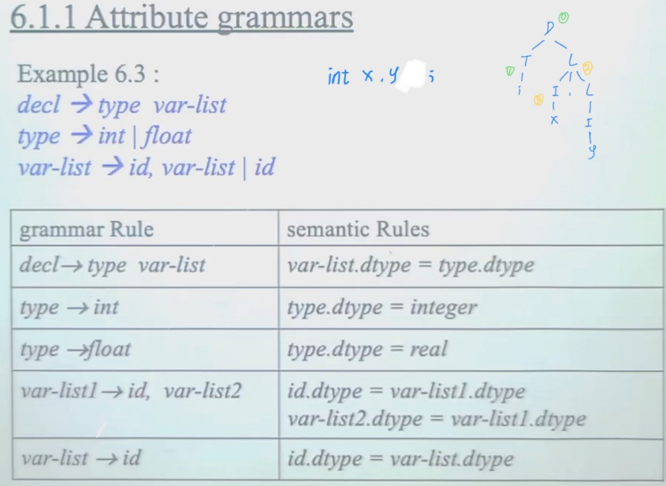
6.1.1 Attribute grammars

Slide 17
6.1.1 Attribute grammars
Example 6.4
based-num → num basechar
basechar → o | d
num → num digit | digit
digit → 0|1|2|3|4|5|6|7|8|9

Slide 18
6.1.1 Attribute grammars
Grammar Rule | Semantic Rules
based-num → num basechar | based-num.val = num.val num.base = basechar.base
basechar → o | basechar.base = 8
basechar → d | basechar.base = 10
num1→ num2 digit | num1.val = If digit.val = error or num2.val = error Then error Else num2.val*num1.base+digit.val num2.base = num1.base digit.base = num1.base
num → digit | num.val = digit.val digit.base = num.base
digit →0 | digit.val = 0
digit →1 | digit.val = 1
..... | .....
digit →7 | digit.val = 7
digit →8 | digit.val = if digit.base = 8 then error else 8
digit →9 | digit.val = if digit.base = 8 then error else 9

Slide 19
6.1.1 Attribute grammars
based-num
(val = 229)
num
(val = 28*8+5=229)
(base=8)
basechar
(base= 8)
o
num
(val = 3*8+4=28)
(base=8)
digit
(val = 5)
(base=8)
num
(val = 3)
(base=8)
digit
(val = 4)
(base=8)
digit
(val = 3)
(base=8)
4
3

Slide 20
6.1.2 Simplifications and Extensions to Attribute Grammars
Metalanguage for the attribute grammar : the collection of expressions allowable in an attribute equation.
  In this book limited to arithmetic, logical and a few other kinds of expressions.
  an if-then-else expression and occasionally a case or switch expression.
Functions can be added to the metalanguage whose definitions may be given elsewhere.
  digit → D (D is understood to be one of the digits)
  digit.val = numval(D)

Slide 21
6.1.2 Simplifications and Extensions to Attribute Grammars
Example 6.5 define an abstract syntax tree for simple integer arithmetic expressions by the attribute grammar as follows:
mknode(root, left, right)
Grammar Rule | Semantic Rules
exp1→ exp2 + term | exp1.tree = mkOpNode(+,exp2.tree , term.tree)
exp1→ exp2 - term | exp1.tree = mkOpNode(-,exp2.tree , term.tree)
exp1→ term | exp1.tree = term.tree
term1→ term2*factor | term1.tree= mkOpNode(*,term2.tree , factor.tree)
term→ factor | term.tree = factor.tree
factor→ (exp) | factor.tree = exp.tree
factor→number | factor.tree = mkNumNode(number.lexval)

